Slide 1
Logistic Regression (Classification algo)

Slide 2
Introduction
Logistic regression is used to analyze relationships between a dependent variable and continuous independent variables.
In Logistic regression, instead of fitting a regression line, we fit an "S" shaped logistic function, which predicts two maximum values (0 or 1).

Slide 3
Why the name?
The model builds a regression model to predict the probability that a given data entry belongs to the category numbered as “1”. Just like Linear regression assumes that the data follows a linear function, Logistic regression models the data using the sigmoid function.

Slide 4
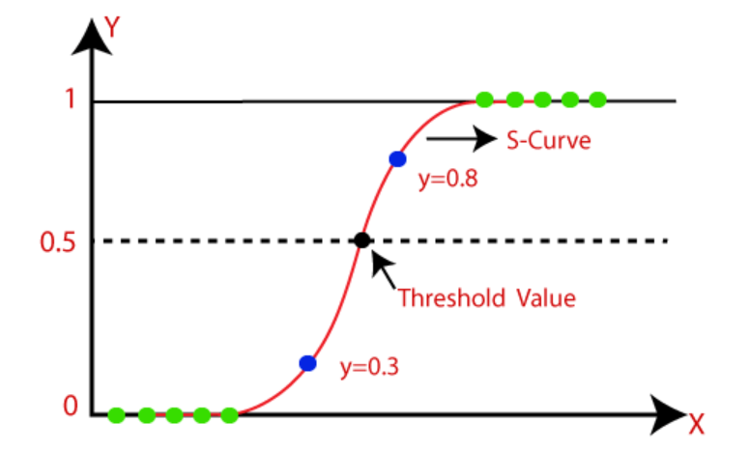
Logistic Function (Sigmoid Function):
The sigmoid function is a mathematical function used to map independent variables to probabilities.
Maps any real value into another value within a range of 0 and 1.
The value of the logistic regression must be between 0 and 1, which cannot go beyond this limit, so it forms a curve like the "S" form. The S-form curve is called the Sigmoid function or the logistic function.
Threshold value: which defines the probability of either 0 or 1.
Above the threshold value: tends to 1.
Below the threshold values: tends to 0.

Slide 5


Equation
We know the equation of the straight line can be written as:
In Logistic Regression y can be between 0 and 1 only, so for this let's divide the above equation by (1-y):
But we need range between -[infinity] to +[infinity], then take logarithm of the equation it will become:

Slide 6
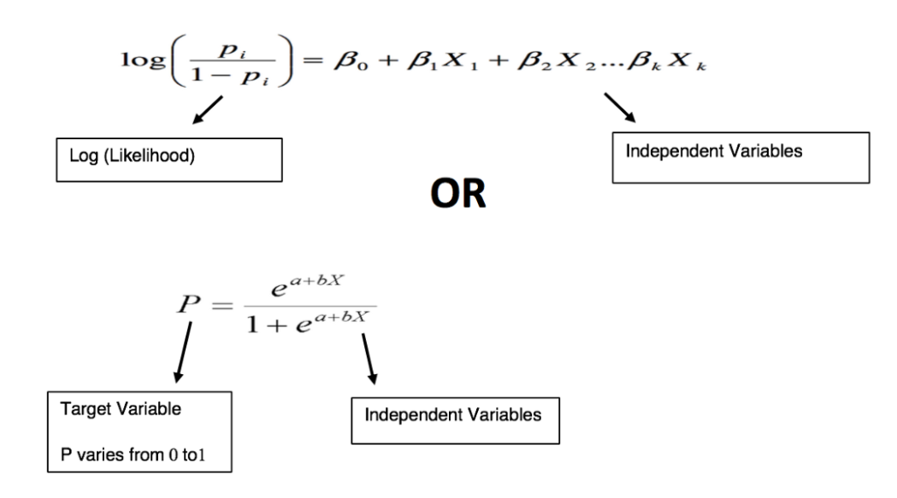
Final equation (Sigmoid Function equation)

Slide 7
Types of Logistic regression
Binomial: In binomial Logistic regression, there can be only two possible types of the dependent variables, such as 0 or 1, Pass or Fail, etc.
Multinomial: In multinomial Logistic regression, there can be 3 or more possible unordered types of the dependent variable, such as "cat", "dogs", or "sheep"
Ordinal: In ordinal Logistic regression, there can be 3 or more possible ordered types of dependent variables, such as "low", "Medium", or "High".

Slide 8
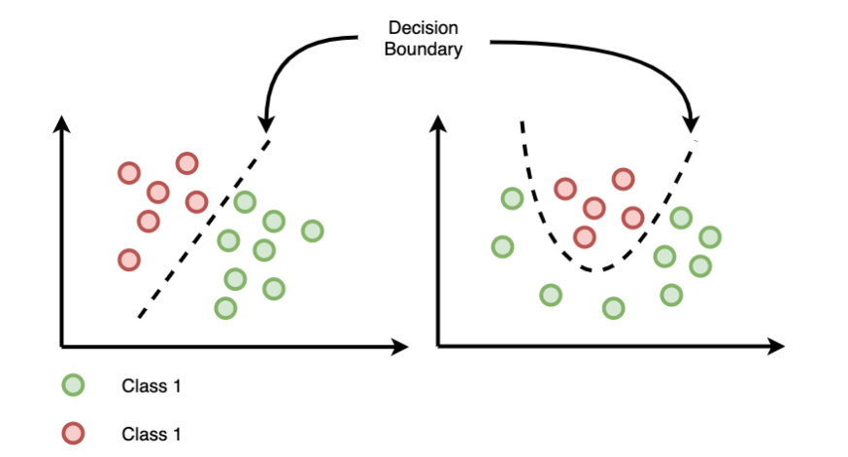

Slide 9
Linear decision boundary
Linear Decision boundary is not to be confused with linear regression

Slide 10
Non Linear Decision Boundary

Slide 11
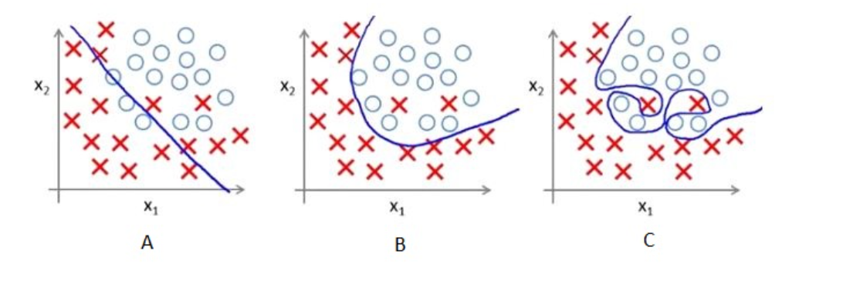
Overfitting and Underfitting in Logistic Regression Decision boundaries

Slide 12
Summary
Training data is fed into the logistic regression model with the help of which it identifies a sigmoid function (a pattern) which the outcome of the training data follows given a certain input.
The sigmoid function is used to classify data points into classes of the testing data set.
After the classification is done, keeping in mind the coordinates of all the data points a decision boundary is created which classifies most of the data points correctly
The decision boundary can be linear or non-linear depending upon the coordinates of the training and testing data points.

